Slide 1




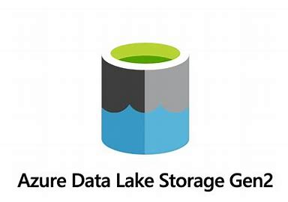

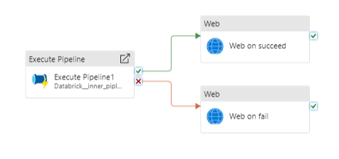
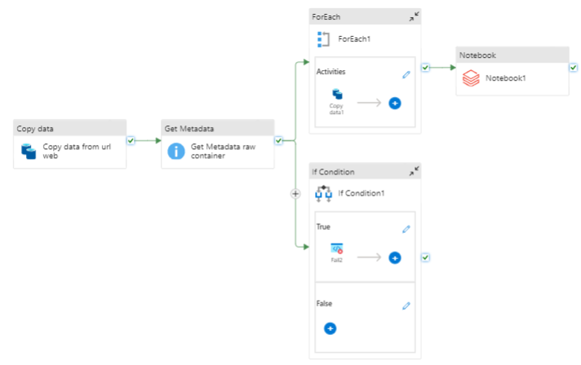
Source
Orchestration
Analysis
Delta table1
Delta table2
Delta table3
Visualization
Raw
.zip1
.zip2
Refined
Joshi
Unzipped
Processed
folder1
.parq1
folder2
.parq2
folder3
.parq3
.csv1
.csv2
.csv3

